Slide 1
Java Classes
Appendix C
© 2015 Pearson Education, Inc., Hoboken, NJ. All rights reserved

Slide 2
Objects and Classes
An object belongs to a class, which defines its data type
A class specifies …
  Kind of data objects of that class have
  What actions the objects can take
  How they accomplish these actions
Object Oriented Programming
  A world consisting of objects that interact with one another by means of actions
© 2015 Pearson Education, Inc., Upper Saddle River, NJ. All rights reserved

Slide 3
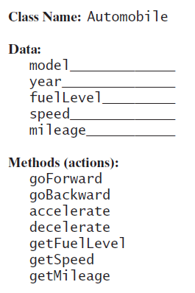
Objects and Classes
Figure C-1 An outline of a class and …
© 2015 Pearson Education, Inc., Upper Saddle River, NJ. All rights reserved

Slide 4
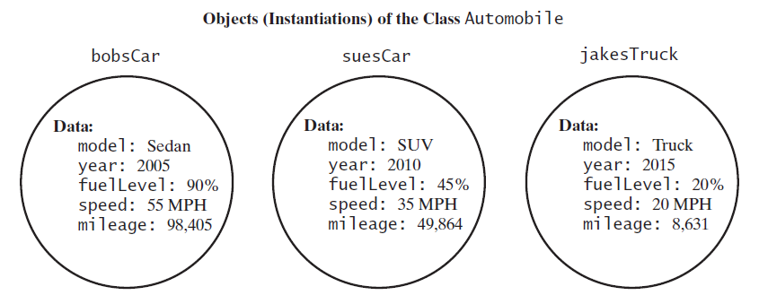
Objects and Classes
… three of its instances
© 2015 Pearson Education, Inc., Upper Saddle River, NJ. All rights reserved

Slide 5

Using the Methods in a Java Class
A program component that uses a class is called a client of the class
The new operator creates an instance of a class
  By invoking a special method within the class
  Known as a constructor
Variable joe references memory location where object is stored
© 2015 Pearson Education, Inc., Upper Saddle River, NJ. All rights reserved

Slide 6

Using the Methods in a Java Class
Figure C-2 A variable that references an object
© 2015 Pearson Education, Inc., Upper Saddle River, NJ. All rights reserved

Slide 7


Using the Methods in a Java Class
Class should have methods that give capability to set data values
  Void methods, they do not return a value.
Class needs methods to retrieve values
  Valued methods, return a value
© 2015 Pearson Education, Inc., Upper Saddle River, NJ. All rights reserved

Slide 8
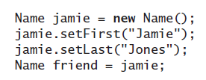
References and Aliases
A reference variable contains the address in memory of an actual object.
Consider:
Variables jamie and friend reference the same instance of Name
© 2015 Pearson Education, Inc., Upper Saddle River, NJ. All rights reserved

Slide 9
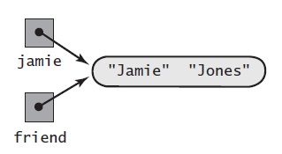
References and Aliases
Figure C-3 Aliases of an object
© 2015 Pearson Education, Inc., Upper Saddle River, NJ. All rights reserved

Slide 10
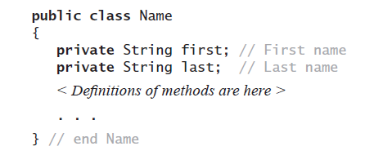
Defining a Java Class
The Java class Name that represents a person’s name.
  Store a class definition in a file
  File name is the name of the class followed by .java.
© 2015 Pearson Education, Inc., Upper Saddle River, NJ. All rights reserved

Slide 11
Defining a Java Class
public means no restrictions on where class is used
Strings first and last are class’s data fields
private means only methods within class can refer to the data fields
© 2015 Pearson Education, Inc., Upper Saddle River, NJ. All rights reserved

Slide 12
Defining a Java Class
private fields accessed by
  Accessor methods (get)
  Mutator methods (set)
© 2015 Pearson Education, Inc., Upper Saddle River, NJ. All rights reserved

Slide 13
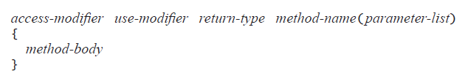
Method Definitions
General form:
  use modifier is optional and in most cases omitted
  return type, (for a valued method), data type of the value method returns
  parameters specify values, objects that are inputs
© 2015 Pearson Education, Inc., Upper Saddle River, NJ. All rights reserved

Slide 14
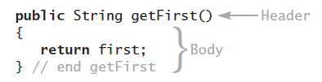
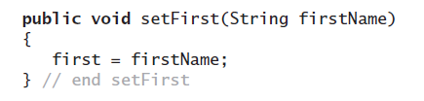
Method Definitions
Examples of get and set methods
Possible to reference class data field first with this.first
  this references “this” instance of the Name object
© 2015 Pearson Education, Inc., Upper Saddle River, NJ. All rights reserved

Slide 15

Arguments and Parameters
Consider:
Strings "Joseph" and "Brown" are the arguments.
  Correspond to the parameters of the method definition
Method invocation must provide exactly as many arguments as parameters as method definition
© 2015 Pearson Education, Inc., Upper Saddle River, NJ. All rights reserved

Slide 16
Passing Arguments
Method cannot change the value of an argument that has a primitive data type
  Mechanism is described as call-by-value.
When parameter has class type, corresponding argument in method invocation must be object of that class type
  Parameter is initialized to the memory address of that object
  Method can change the data in the object
© 2015 Pearson Education, Inc., Upper Saddle River, NJ. All rights reserved

Slide 17
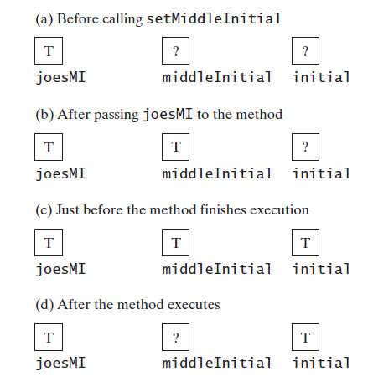
Passing Arguments
Figure C-4 The effect of executing the method
setMiddleInitial on its argument joesMI, its parameter middleInitial, and the data field initial
© 2015 Pearson Education, Inc., Upper Saddle River, NJ. All rights reserved

Slide 18
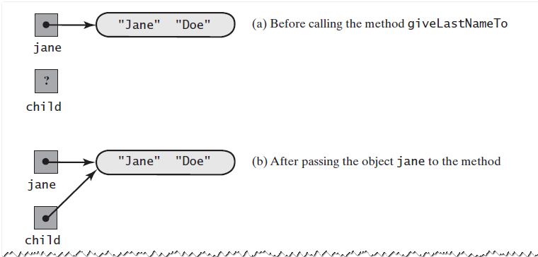
Passing Arguments
Figure C-5 The method giveLastNameTo modifies
the object passed to it as an argument
© 2015 Pearson Education, Inc., Upper Saddle River, NJ. All rights reserved

Slide 19
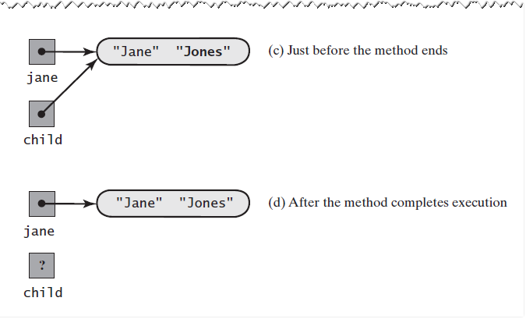
Passing Arguments
Figure C-5 The method giveLastNameTo modifies
the object passed to it as an argument
© 2015 Pearson Education, Inc., Upper Saddle River, NJ. All rights reserved

Slide 20
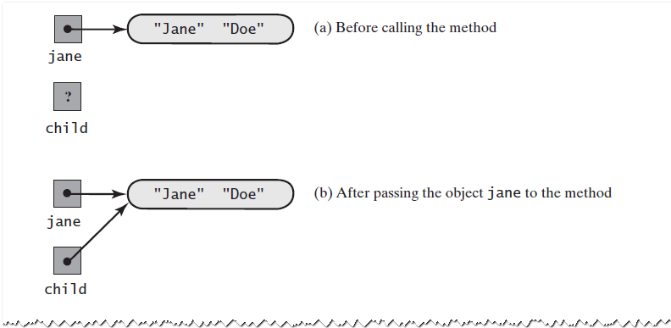
Passing Arguments
Figure C-6 A method cannot replace an
object passed to it as an argument
© 2015 Pearson Education, Inc., Upper Saddle River, NJ. All rights reserved

Slide 21
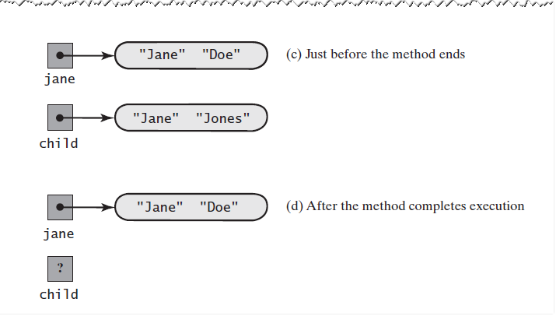
Passing Arguments
Figure C-6 A method cannot replace an
object passed to it as an argument
© 2015 Pearson Education, Inc., Upper Saddle River, NJ. All rights reserved

Slide 22
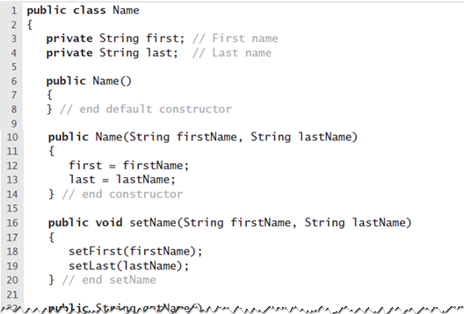
A Definition of the Class Name
LISTING C-1 The class Name
© 2015 Pearson Education, Inc., Upper Saddle River, NJ. All rights reserved

Slide 23
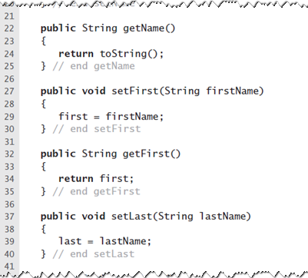
A Definition of the Class Name
LISTING C-1 The class Name
© 2015 Pearson Education, Inc., Upper Saddle River, NJ. All rights reserved

Slide 24
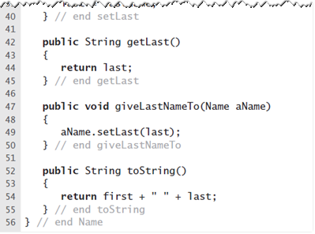
A Definition of the Class Name
LISTING C-1 The class Name
© 2015 Pearson Education, Inc., Upper Saddle River, NJ. All rights reserved

Slide 25
Constructors
Constructor allocates memory for object, initializes the data fields
Constructor has certain special properties
  Same name as the class
  No return type, not even void
  Any number of parameters, including no parameters
Constructor without parameters called the default constructor
© 2015 Pearson Education, Inc., Upper Saddle River, NJ. All rights reserved

Slide 26

Constructors
Consider these two statements:
  Second statement allocates new memory, with jill pointing to it
  Previous memory location “lost”
  System periodically deallocates, returns to O.S.
© 2015 Pearson Education, Inc., Upper Saddle River, NJ. All rights reserved

Slide 27
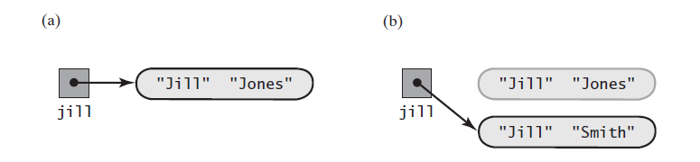
Constructors
Figure C-7 An object (a) after its initial creation;
(b) after its reference is lost
© 2015 Pearson Education, Inc., Upper Saddle River, NJ. All rights reserved

Slide 28

The Method toString
Method toString in class Name returns a string that is person’s full name
  Java will invoke it automatically when you write
Providing a class with a method toString is a good idea in general
© 2015 Pearson Education, Inc., Upper Saddle River, NJ. All rights reserved

Slide 29
Methods That Call Other Methods
setName could use assignment statements to initialize first and last
  Instead invokes the methods setFirst and setLast
Method getName in the class Name also invokes another of Name’s methods
  Uses toString
  Rather than writing same statements in both methods, we have one method call the other
© 2015 Pearson Education, Inc., Upper Saddle River, NJ. All rights reserved

Slide 30
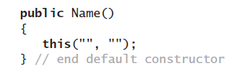
Methods That Call Other Methods
Can use the reserved word this to call a constructor
  From within the body of another constructor.
  Revision of default constructor to initialize first and last, by calling the second constructor
© 2015 Pearson Education, Inc., Upper Saddle River, NJ. All rights reserved

Slide 31
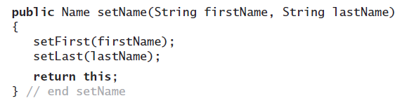

Methods That Return an Instance of Their Class
Could have setName return reference to revised instance of Name, as follows:
  Can call this definition of setName
© 2015 Pearson Education, Inc., Upper Saddle River, NJ. All rights reserved

Slide 32
Static Fields and Methods
Sometimes you need a data field that does not belong to any one object
  Such a data field is called a static field
Objects can use static field to communicate with each other
  Or to perform some joint action.
© 2015 Pearson Education, Inc., Upper Saddle River, NJ. All rights reserved

Slide 33
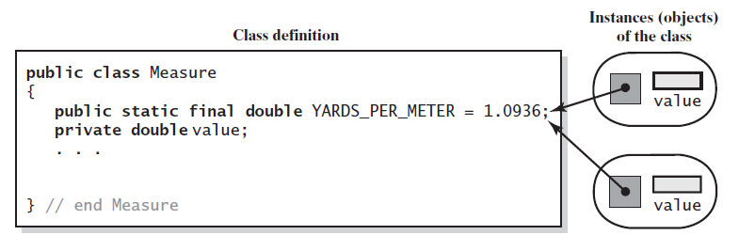
Static Fields and Methods
Figure C-8 A static field YARDS_PER_METER
versus a nonstatic field value. Objects of the class Measure all reference the same static field but have their own copy of value
© 2015 Pearson Education, Inc., Upper Saddle River, NJ. All rights reserved

Slide 34

Static Fields and Methods
Static method: a method that does not belong to an object of any kind.
  Still a member of a class
  Use the class name instead of an object name to invoke the method
Methods from class Math
© 2015 Pearson Education, Inc., Upper Saddle River, NJ. All rights reserved

Slide 35

Overloading Methods
Methods within same class can have same name,
  As long as they do not have identical parameters
© 2015 Pearson Education, Inc., Upper Saddle River, NJ. All rights reserved

Slide 36
Enumeration as a Class
When you define an enumeration, the class created has methods such as
  toString, equals, ordinal, and valueOf
You can define additional methods for any enumeration
  Including constructors
© 2015 Pearson Education, Inc., Upper Saddle River, NJ. All rights reserved

Slide 37
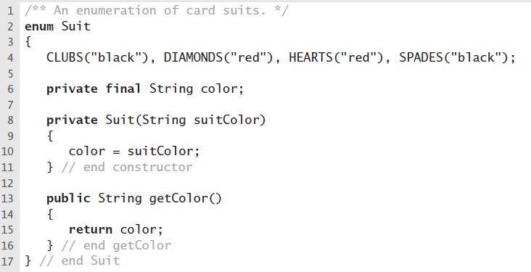
Enumeration as a Class
LISTING C-2 The enumeration Suit
© 2015 Pearson Education, Inc., Upper Saddle River, NJ. All rights reserved

Slide 38
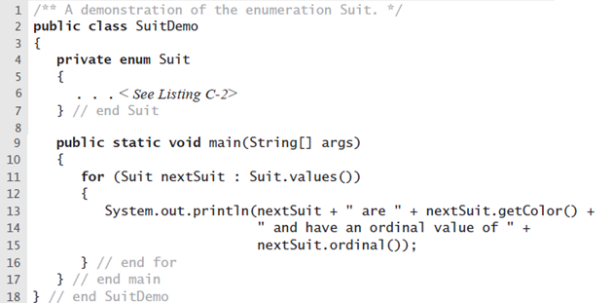
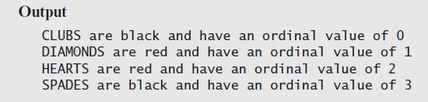
Enumeration as a Class
LISTING C-2 The enumeration Suit
© 2015 Pearson Education, Inc., Upper Saddle River, NJ. All rights reserved

Slide 39
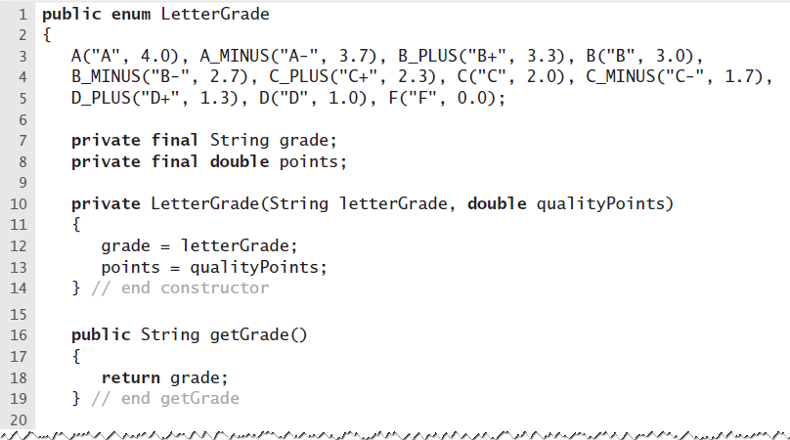
Enumeration as a Class
LISTING C-4 The enumeration LetterGrade
© 2015 Pearson Education, Inc., Upper Saddle River, NJ. All rights reserved

Slide 40
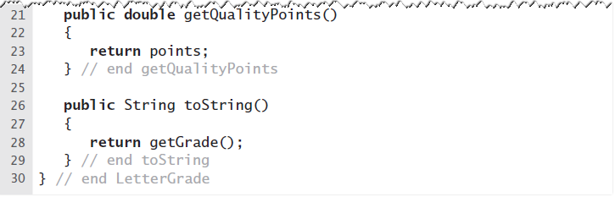
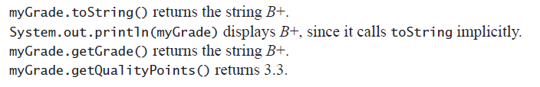
Enumeration as a Class
LISTING C-4 The enumeration LetterGrade
Given LetterGrade myGrade = LetterGrade.B_PLUS;
Then …
© 2015 Pearson Education, Inc., Upper Saddle River, NJ. All rights reserved

Slide 41
Packages
Using several related classes is more convenient if …
  You group them together within a Java package
To identify a class as part of a particular package
  Begin the file that contains the class with a statement like package myStuff;
  Then place all of the files within one directory or folder, give it same name as the package.
© 2015 Pearson Education, Inc., Upper Saddle River, NJ. All rights reserved

Slide 42
Packages
To use a package in your program …
  Begin the program with a statement such as import myStuff.*;
Asterisk makes all public classes within package available to the program
© 2015 Pearson Education, Inc., Upper Saddle River, NJ. All rights reserved

Slide 43
The Java Class Library
Java comes with a collection of many classes you can use
  This collection of classes is known as the Java Class Library
  Sometimes as the Java Application Programming Interface
© 2015 Pearson Education, Inc., Upper Saddle River, NJ. All rights reserved

Slide 44
Java Classes
End
© 2015 Pearson Education, Inc., Upper Saddle River, NJ. All rights reserved

